Slide 1
Unit 2: For Live Session Assignment

Slide 2
Put each on its own slide(s) and include your code!
Download into R Studio the PlayerBBall.csv dataset. This data set is every NBA basketball player from 1950 to present. It contains their height, weight, position and the year they played (among other data.) (Position: F-Forward, C-Centers, F-C and C-F – Forward /Centers, G – Guards, F-G – Forward/Guards) FYI: If you feel that these questions are open ended or at least a little vague, this is on purpose. Answer the question as you understand it and make any assumptions you need to make to answer the question and record those assumptions. (3-5 hours)
1-Use the PlayerBBall.csv dataset to visually represent (summarize) the number of players in each position.
2-Use the dataset to visually investigate the distribution of the weight of centers (C) is greater than the distribution of the weight of forwards (F).
3-Use the dataset to visually investigate if the distribution of the height of centers (C) is greater than the distribution of the height of forwards (F).
4-Use the dataset to visually investigate if the distribution of height is different between any of the positions.
5-Use the dataset to investigate how the player’s height is related to the player’s weight. How does height change as the weight changes?
6-Is their any difference in the relationship between height and weight between positions? Are height and weight related differently for different positions.
7-A historian would like to investigate the claim that the heights of players have increased over the years. Analyze this claim graphically / visually.
8-Create a 3D plot of height vs. weight vs. year and color code the points by position.
9-Go to this website and use one of the 50 best plots to visualize some aspect of the data and provide at least one insight. You will present your work in breakout! http://r-statistics.co/Top50-Ggplot2-Visualizations-MasterList-R-Code.html
Separate dataset: The EducationIncome.csv dataset has incomes of randomly selected Americans and their level of education. (1-2 hours)
Visually test the claim that the distribution of incomes increase (mean or median) as the education level rises.

Slide 3
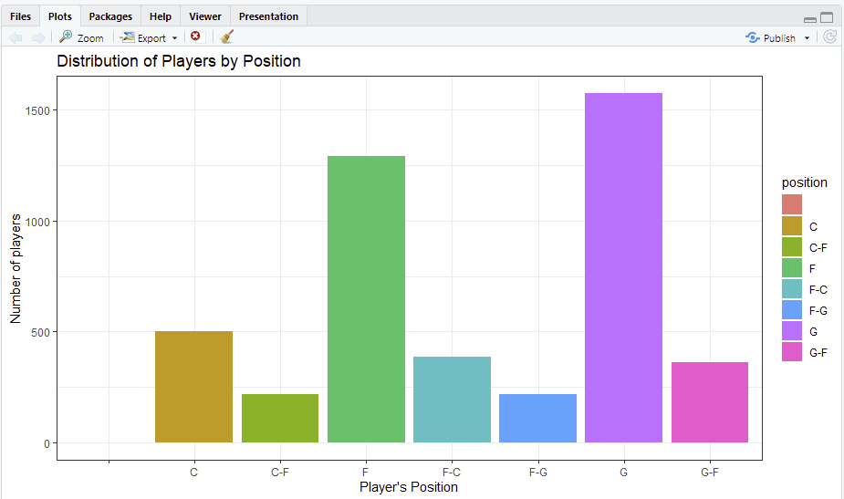
1-Use the PlayerBBall.csv dataset to visually represent (summarize) the number of players in each position

Slide 4
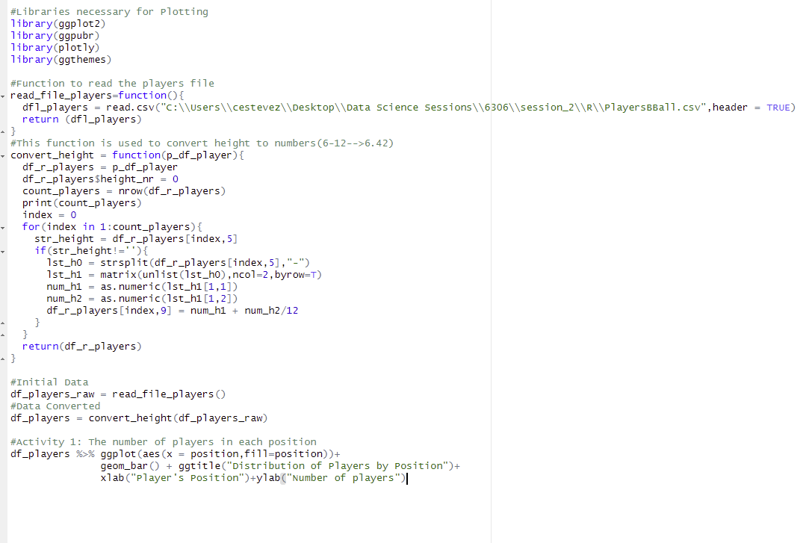
1-Use the PlayerBBall.csv dataset to visually represent (summarize) the number of players in each position
Code
Read the file
Convert Pl.Height to Number
Plotting the data

Slide 5
1-Use the PlayerBBall.csv dataset to visually represent (summarize) the number of players in each position
Take away and Conclusion:
As we can see in the bar graph there are more number of NBA players who play the guard and forward position in the NBA than the rest of other positions

Slide 6
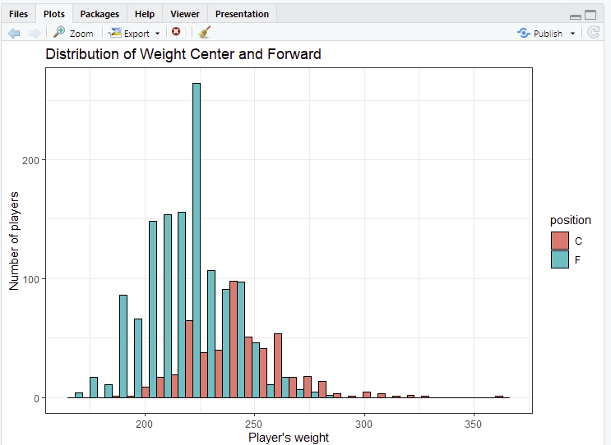
2-Use the dataset to visually investigate the distribution of the weight of centers (C) is greater than the distribution of the weight of forwards

Slide 7
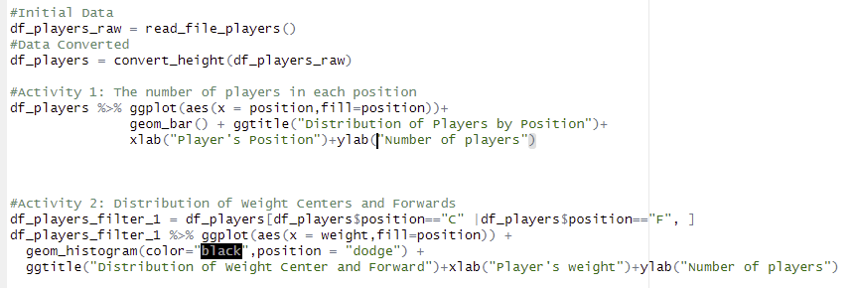
2-Use the dataset to visually investigate the distribution of the weight of centers (C) is greater than the distribution of the weight of forwards
Code
We filter position C and F
Plotting the data

Slide 8
2-Use the dataset to visually investigate the distribution of the weight of centers (C) is greater than the distribution of the weight of forwards
Take away and Conclusion:
As we can see from the image, the distribution of weight for players who play the center position is greater
When we take a look at the blue rectangle we notice that most of the centers weight over 225lbs with perhaps rare cases below this value
On the other hand, if we take a look at the green rectangle we can notice that most of the forwards weight less than 250lbs

Slide 9
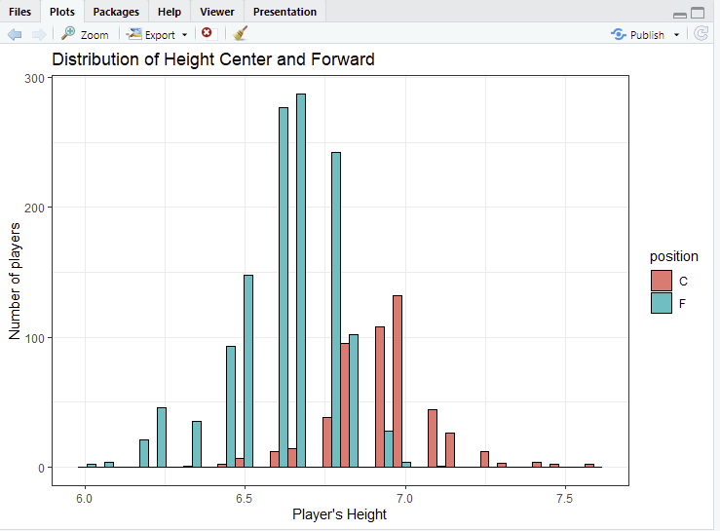
3-Use the dataset to visually investigate if the distribution of the height of centers (C) is greater than the distribution of the height of forwards (F)

Slide 10
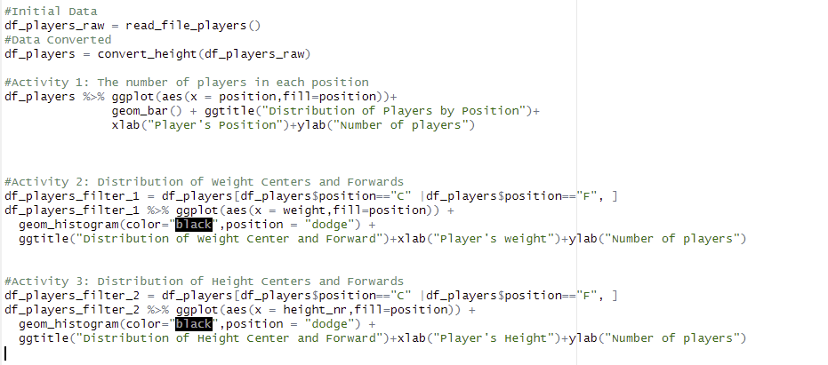
3-Use the dataset to visually investigate if the distribution of the height of centers (C) is greater than the distribution of the height of forwards (F)
We filter position C and F
Plotting the data

Slide 11
3-Use the dataset to visually investigate if the distribution of the height of centers (C) is greater than the distribution of the height of forwards (F)
Take away and Conclusion:
We can see right away that the height distribution of Centers is way much greater than the Height distribution for forward s
Most of the Centers in the NBA according to the bar graph are about 7 feet tall

Slide 12
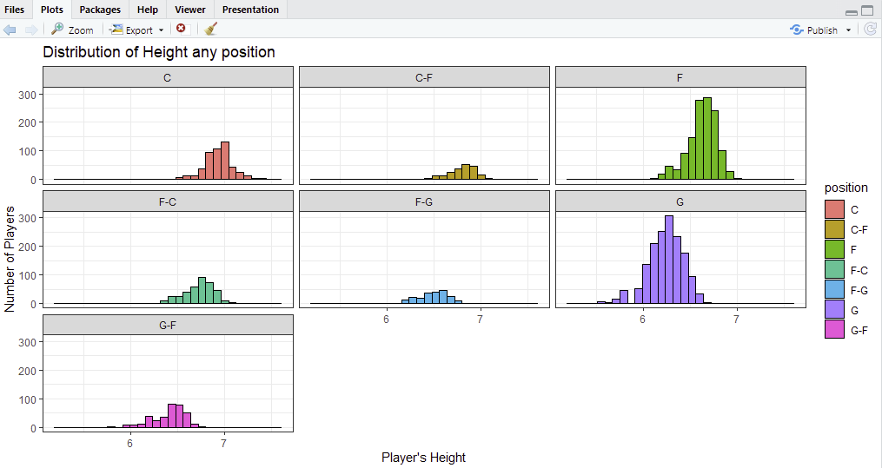
4-Use the dataset to visually investigate if the distribution of height is different between any of the positions.

Slide 13
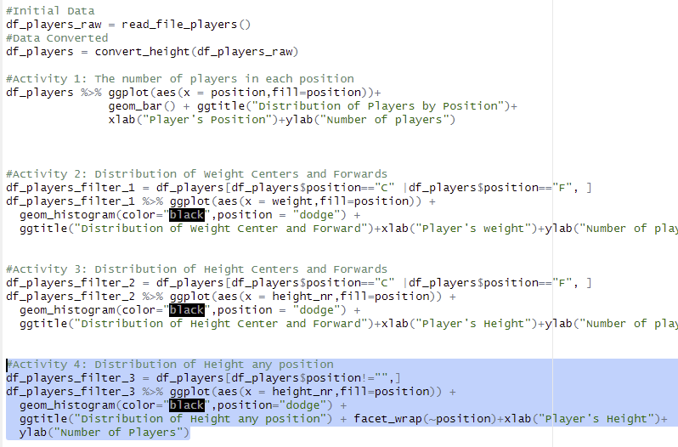
4-Use the dataset to visually investigate if the distribution of height is different between any of the positions.
Code
Plotting the data

Slide 14
4-Use the dataset to visually investigate if the distribution of height is different between any of the positions.
Take away and Conclusion:
The distribution of height looks very similar. It seems that most of the NBA players are between 6 and 7 feet tall

Slide 15
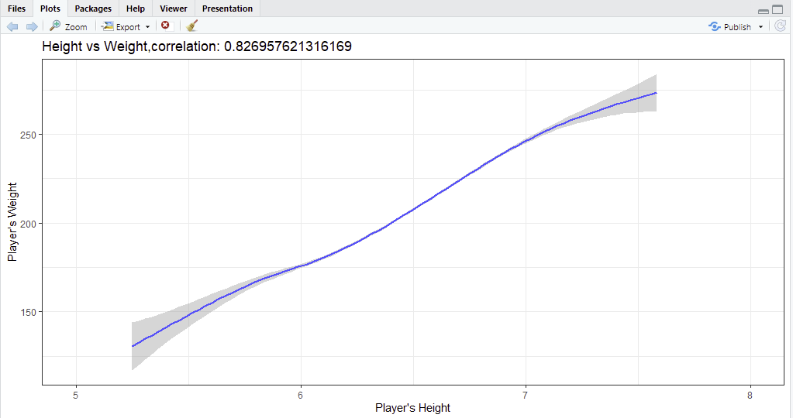
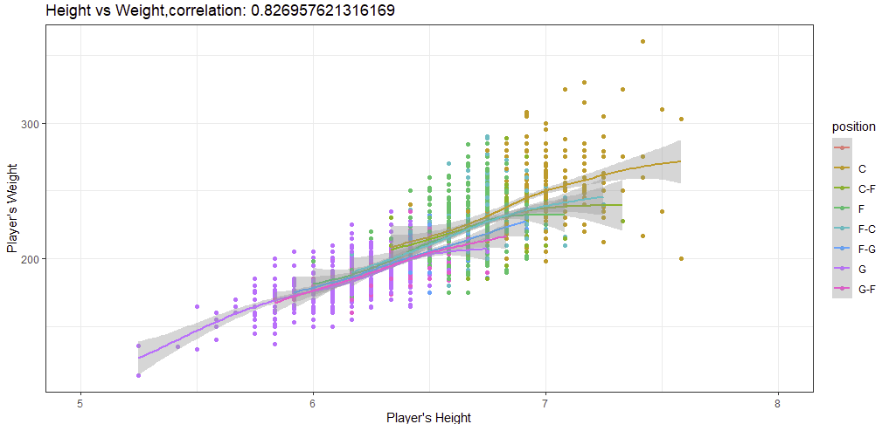
5-Use the dataset to investigate how the player’s height is related to the player’s weight. How does height change as the weight changes?

Slide 16
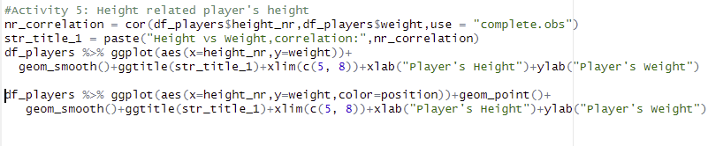
5-Use the dataset to investigate how the player’s height is related to the player’s weight. How does height change as the weight changes?
Correlation Coefficient
We wanted to make sure there’s a linear relationship
Scatter Plot 1
Scatter Plot 2

Slide 17
5-Use the dataset to investigate how the player’s height is related to the player’s weight. How does height change as the weight changes?
Take away and Conclusion:
As we can see from both graphs it looks like there’s a linear relation between Height and Weight
We also have calculated the correlation coefficient which is 0.82 which indicates that there’s a strong linear relationship
So according to the data, the tallest NBA players should be the ones who weight most!!!

Slide 18
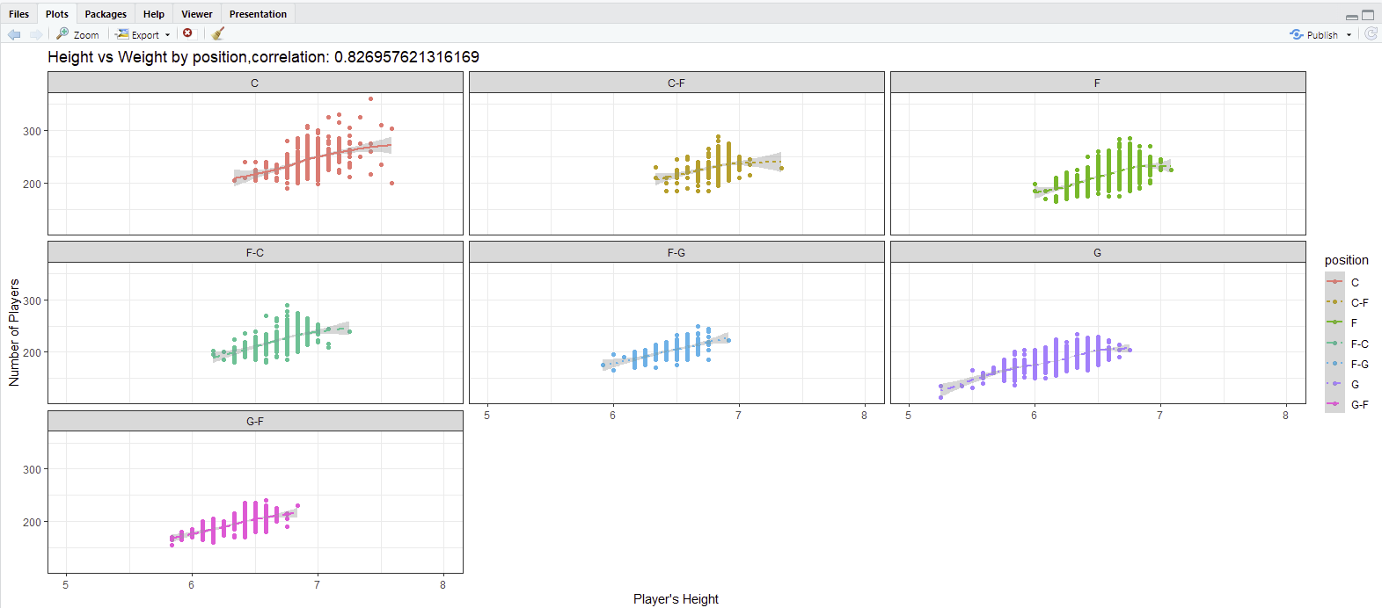
6-Is their any difference in the relationship between height and weight between positions? Are height and weight related differently for different positions.

Slide 19
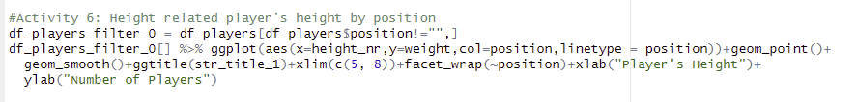
6-Is their any difference in the relationship between height and weight between positions? Are height and weight related differently for different positions.
Plotting the data
Take away and Conclusion:
It seems there’s a linear relation between height and weight for each player’s position

Slide 20
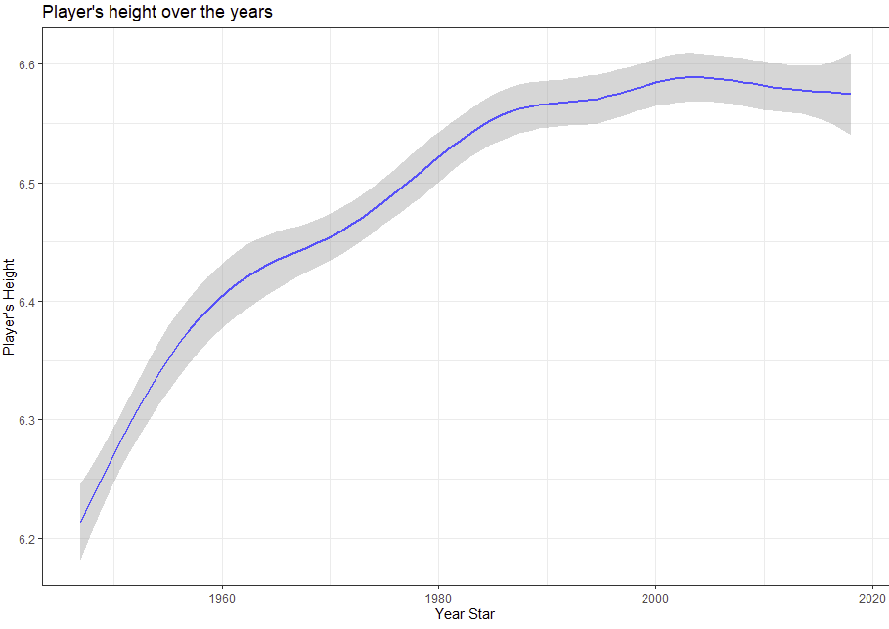
7-A historian would like to investigate the claim that the heights of players have increased over the years. Analyze this claim graphically / visually.

Slide 21
7-A historian would like to investigate the claim that the heights of players have increased over the years. Analyze this claim graphically / visually.
Plotting the data
Take away and Conclusion:
According to the data we can conclude that the claim is certainly true. The Player’s height has been growing over the years

Slide 22
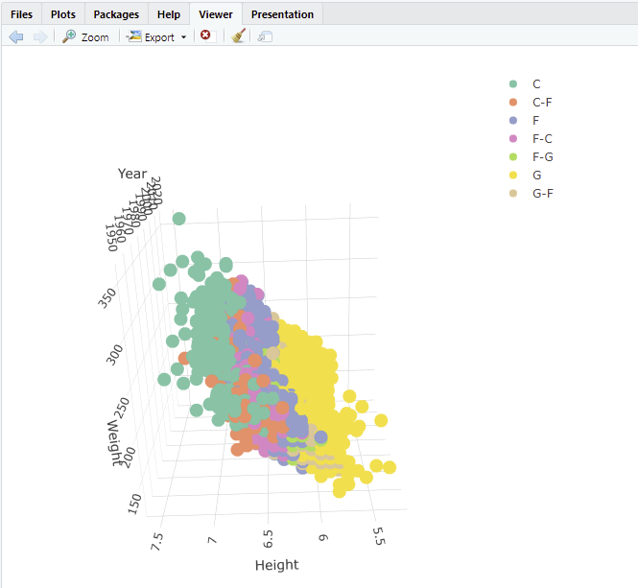
8-Create a 3D plot of height vs. weight vs. year and color code the points by position.

Slide 23
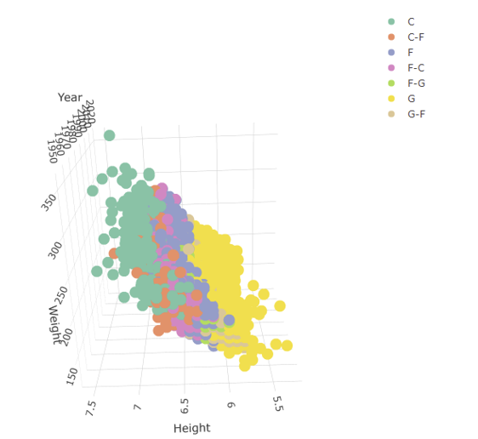
8-Create a 3D plot of height vs. weight vs. year and color code the points by position.
Plotting the data
Take away and Conclusion:
We can see that as height increase then weight increase
We also validated this claim in one of the past slides

Slide 24
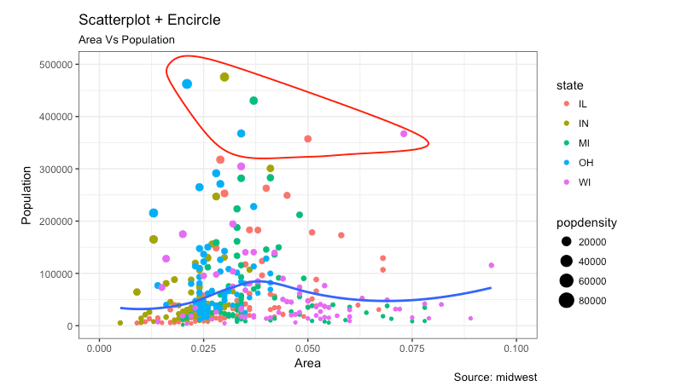
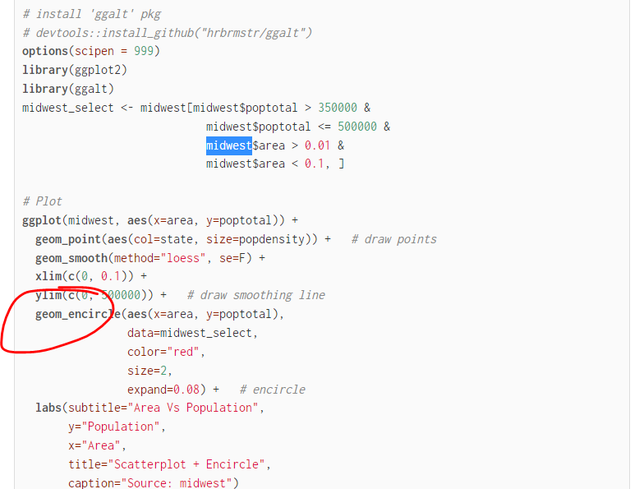
9-Go to this website and use one of the 50 best plots to visualize some aspect of the data and provide at least one insight. You will present your work in breakout! http://r-statistics.co/Top50-Ggplot2-Visualizations-MasterList-R-Code.html
One point that caught my attention from this graph was the elevated population of OHIO in comparison with other states like Wisconsin
On top of that, how the population of people decreased as the Area of the state or zone increases. It seems that most of the people live in smaller areas(Cities)

Slide 25
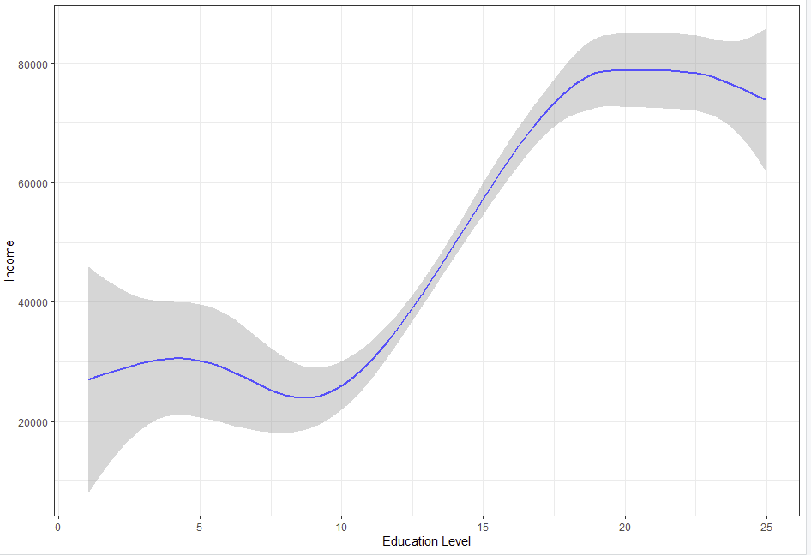
9-Is Visually test the claim that the distribution of incomes increase (mean or median) as the education level rises

Slide 26
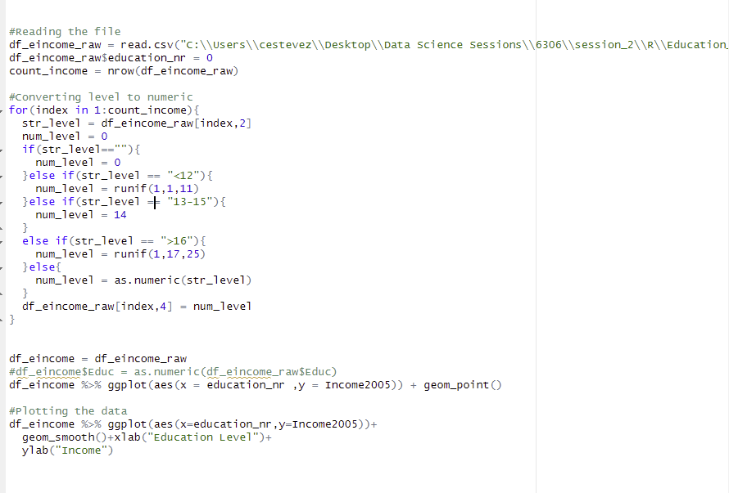
9-Is Visually test the claim that the distribution of incomes increase (mean or median) as the education level rises
Reading the file and converting education level to numeric
Plotting the data

Slide 27
9-Is Visually test the claim that the distribution of incomes increase (mean or median) as the education level rises
Take away and Conclusion:
It seems that income increases as the level of education rises, however, this relation is not lineal

Slide 28
Questions
I want to know your opinion in terms of converting data. For example in one of the questions I converted the player’s height from string to numeric(6-5→6.41). To me, it is much easier this way, but I would like to know your POV
Maybe recommend a book for String function handling

